Slide 1


MICRO CREDIT LOAN USE CASE
By Avinash Patel

Slide 2


INDEX
Importing Dataset
Cleaning The Dataset
Visualization
Skewness and Outlier Removal
Model Selection
Hyperparameter Tuning
Saving The Model

Slide 3
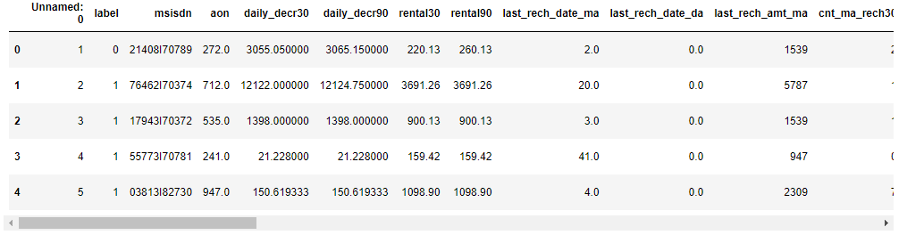
Importing Dataset
First step is to import the csv file into the Jupiter notebook.

Slide 4
After importing we check any of the columns have null values or not and also see
some basic information's about all the columns.
Like number of unique variables in each columns.

Slide 5
Cleaning The Dataset
After some information about the dataset we are going to clean the columns individually.
Categorical Column: There are two categorical column one of them is phone number and we are going to delete this column as it is of no use for us.The other column is date so we are going to separate the day and month and make two separate columns for those.
Numerical Column:
Treating aon column:"aon" is defined as "age on cellular network in days" that means if we consider the average life expectancy for Indonesia is "71.72" years so we will multiply 365 days to it to get the maximum days a person could have a number. This assumption is based upon the data provided on the internet and I am not considering the age limit to get a number to be on the safe side.
So, 72*365=26,280 days . Any number more than this is an outlier and we will work on that row accordingly.

Slide 6
Treating last_rech_date_ma column: All the values in this columns are less then 100 and all the above values are too high to be the number of days. Also some of the values are in negative and days could not be in negative
Treating last_rech_date_da column: By looking at the xml file this column has mostly 0 as values. Hence I am checking how many 0 there are.
Treating cnt_da_rech90 and fr_da_rech90 columns : According to the df.describe() method we can safly say that more than 75% data is 0 which is of no use.So we are going to drop these columns as well.
Treating cnt_ma_rech90 and fr_ma_rech90 column:As both of these columns have the same definition according to the Data_Descriprion xml file so we are going to drop one of the column.

Slide 7
Treating cnt_loans90 column:We can see there is a abnormal maximum value 4997.517944 in this column and 30 is the 75% of the values so we are going to delete any value higher than 100 just to be on the safe side.
Treating medianamnt_loans90 column:As we can see from this table that more than 75% of this column's data is 0 so we are going to delete this column.

Slide 8
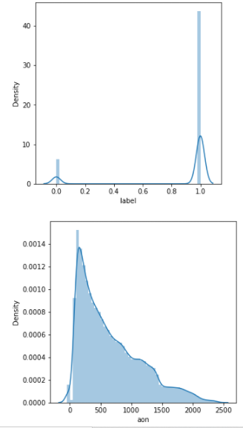
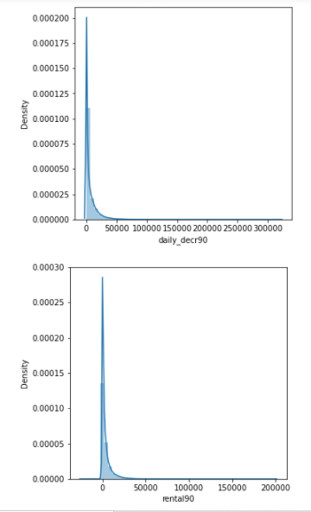
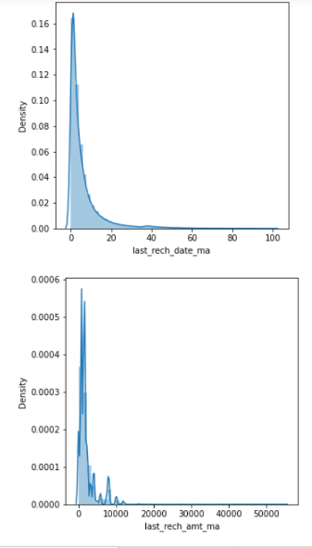
Visualization
Distplot:

Slide 9
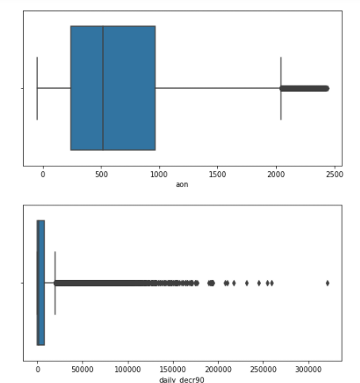
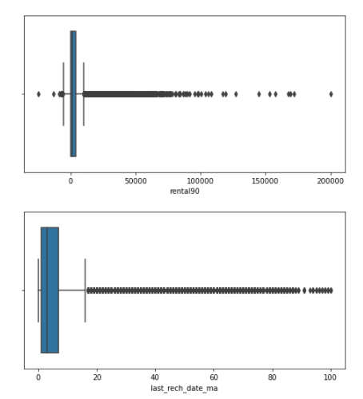
Boxplot

Slide 10
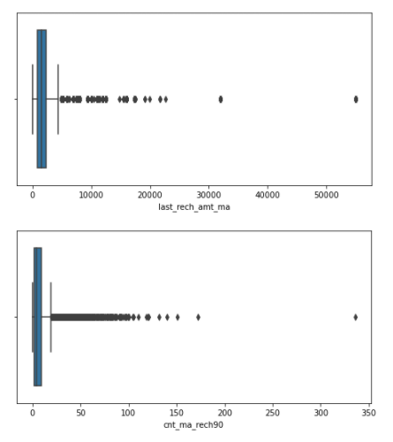
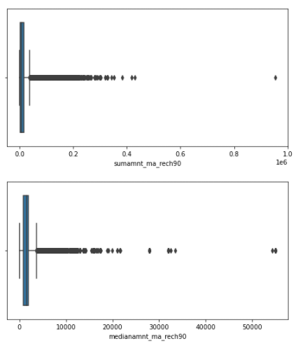

Slide 11
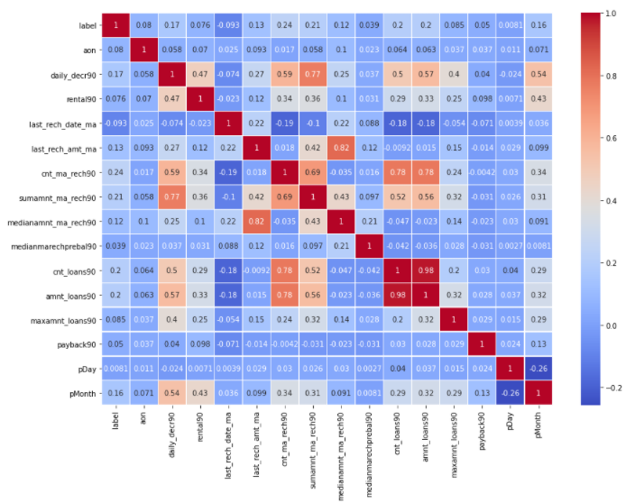
Heatmap

Slide 12
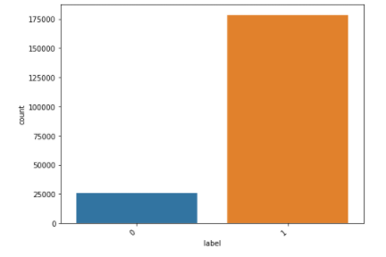
Count plot
As we can see the data is clearly highly imbalanced.

Slide 13
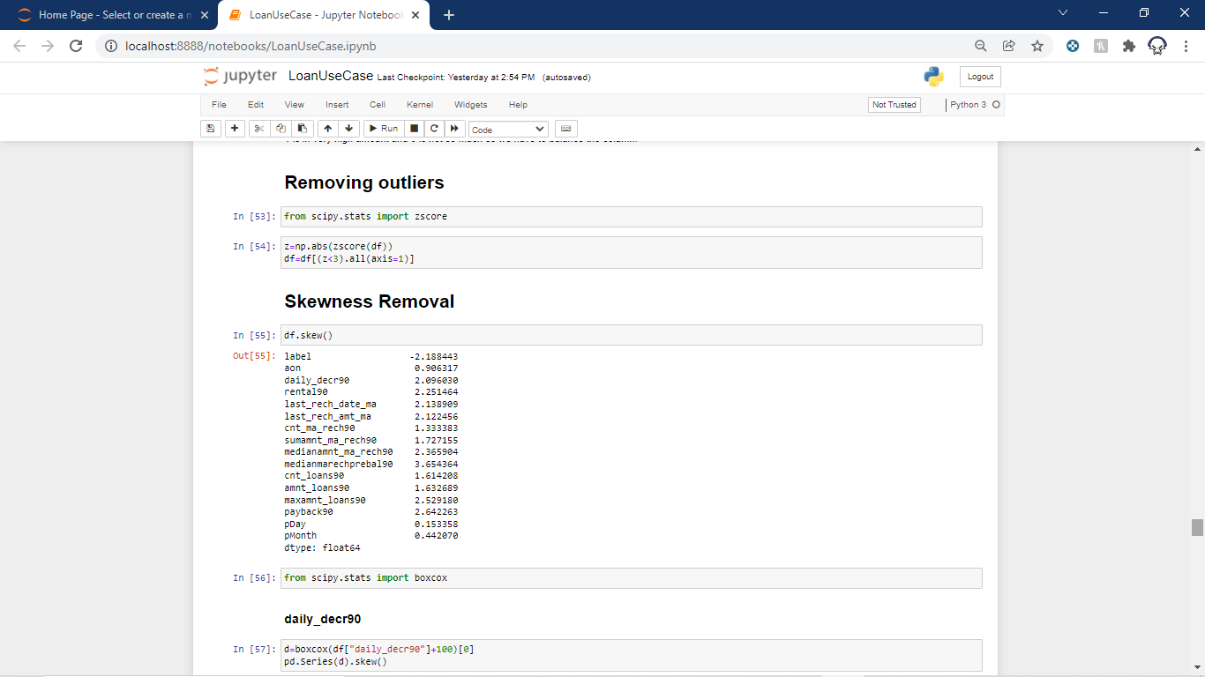
Skewness and Outlier Removal
Now we try to remove some outliers with z-score and then we remove some skewness from some columns.

Slide 14
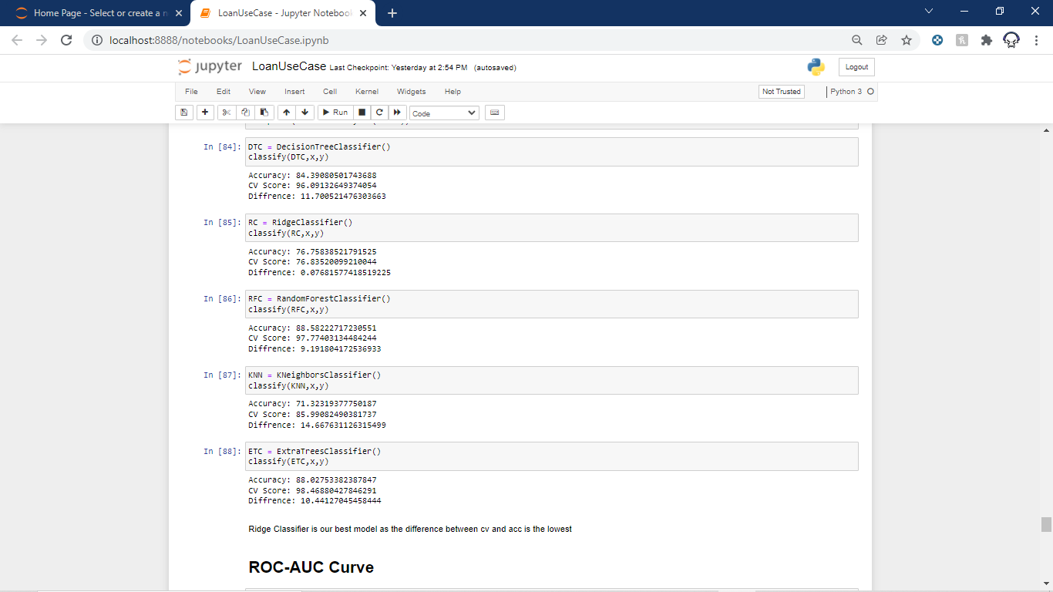
Model Selection
Now we will see some accuracy and cross validation scores of different model so that we can select the best fit model for our project.
Hence Ridge classifier has the lowest difference between accuracy and cross validation score.

Slide 15
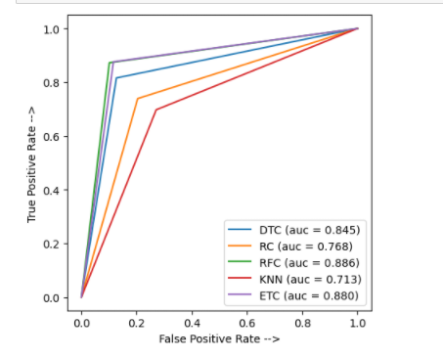
ROC-AUC Curve

Slide 16
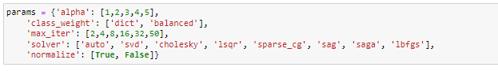
Hyperparameter Tuning
Now as we selected Ridge Classifier as our model. Now we are going to tune its parameters to make the model a little better.
Parameters are:

Slide 17
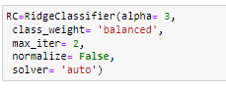
After doing the tuning we find out the following.
The Above parameters are the best parameter for this type of dataset for our model. So finally we fitted the data with these parameters.

Slide 18
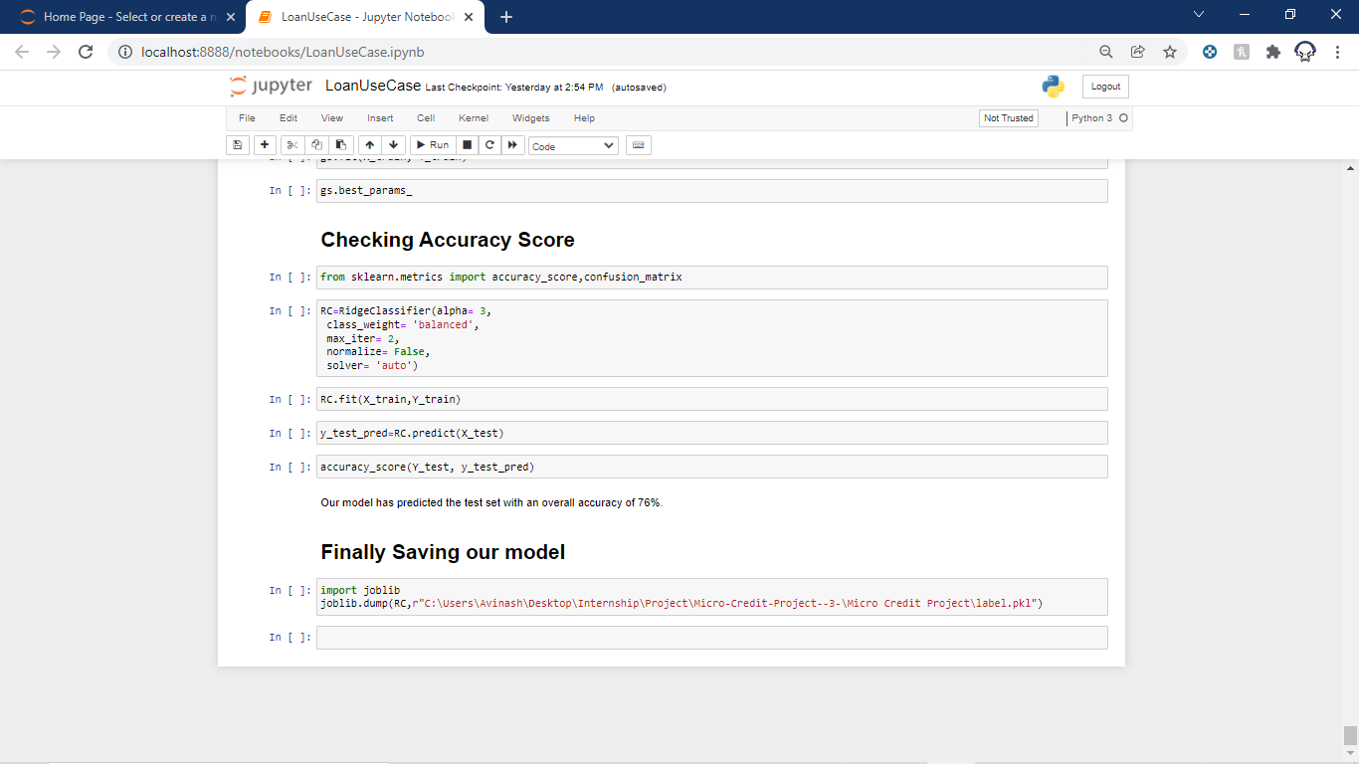
Saving The Model
The final job is to save the model which is done by Joblib library.

Slide 19
THANK YOU!!!

